Slide 1
W4111 – Introduction to Databases Section 002, Spring 2025 Introduction to Project Template
© Donald F. Ferguson, 2025

Slide 2

Introduction
2 | COMS W4111_002_2025_1 – Introduction to Project Template © Donald F. Ferguson, 2025

Slide 3
Two Common Database Applications
Operational/Interactive:
Users and roles can create, retrieve, update, search and delete “records.”
Examples: SSOL, ATMs, … …
Business Intelligence, Decision Support, …:
Users can perform complex queries and analyze a lot of data to generate a report, make a decision, … …
Examples: Build AI/ML training data, dashboards, reports, … …
Some of our major datasets this semester will be:
IMDB: https://developer.imdb.com/non-commercial-datasets/
Game of Thrones: https://developer.imdb.com/non-commercial-datasets/
Lahman’s Baseball Dataset: http://seanlahman.com/
… …
We will build a simple web application and do some data engineering.

Slide 4
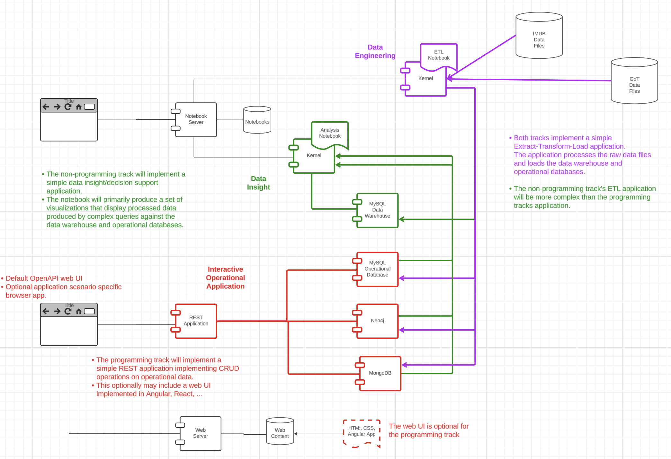
Overall Project Structure
There are three facets to the course project:
Both tracks import data from files and do some simple data engineering.
The programming track implements a simple full-stack web application that uses the imported data.
The non-programming track:
Implements more challenging data engineering.
Write complex queries that produce data used for visualization.

Slide 5
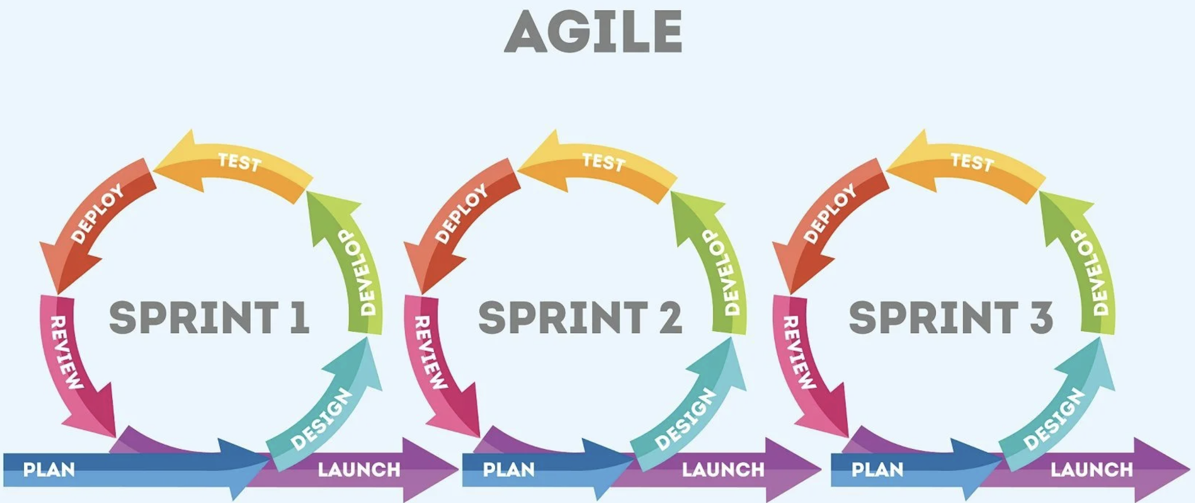
Agile Development
You will do a very simple form of Agile Development. Review involves submitting your homework for grading.
Sprint 1 is simply to: 1) Demonstrate that you can clone and execute the project template. 2) Submit your proposed dataset for approval.
Sprint 2 will implement the tasks using SQL.
Sprint 3 will add MongoDB and Neo4j.
Or, you can just use the sample dataset I use.

Slide 6
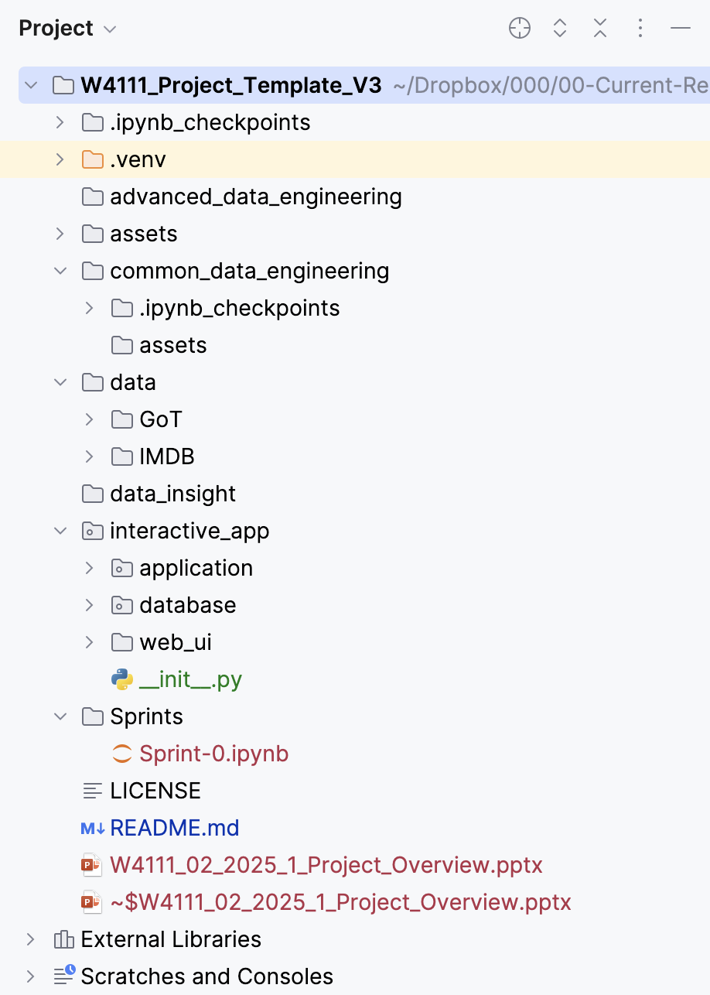
Project Structure
Non-programming:
advanced_data_engineering will contain examples and templates of advanced data engineering tasks.
data_insight will contain examples and templates for complex queries and visualization.
Programming is in interactive_app and there are examples and templates”
application is the middle-tier ”business logic.”
database holds DDL and other setup scripts.
web_UI is a simple, Angular web UI.
Common
assets holds miscellaneous images, etc.
common_data_engineering will contain examples and templates for the data engineering.
data holds the datasets for Prof. Ferguson’s examples.
Sprints will contain the templates for sprints.

Slide 7
Common Data Engineering
7 | COMS W4111_002_2025_1 – Introduction to Project Template © Donald F. Ferguson, 2025

Slide 8
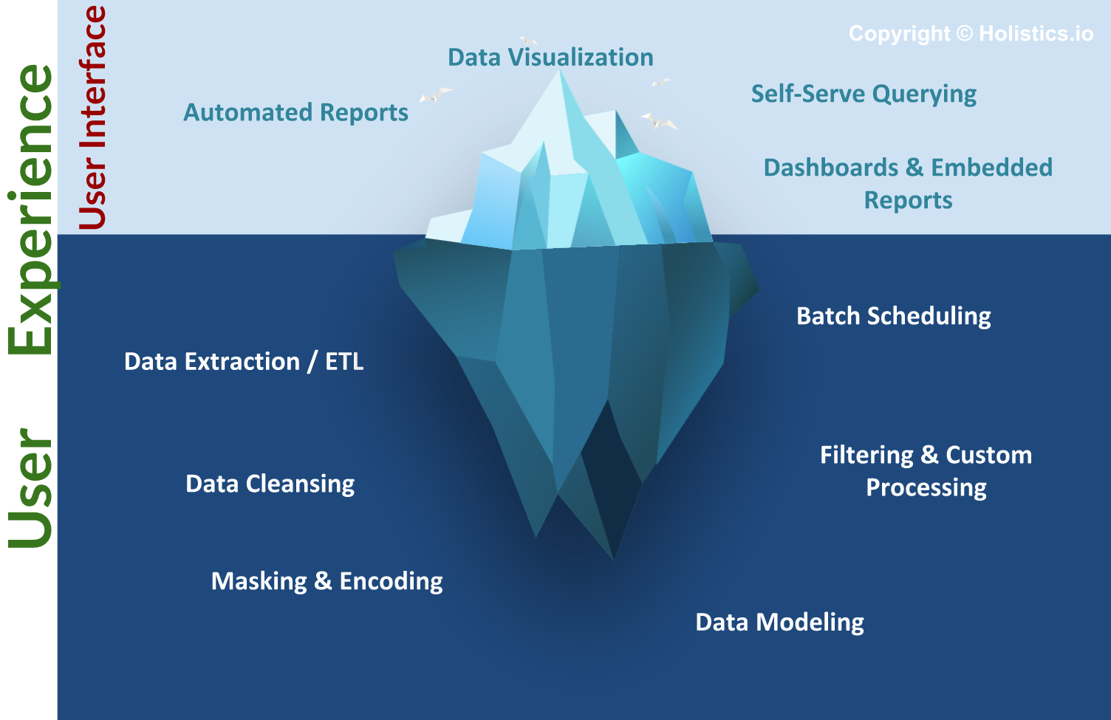
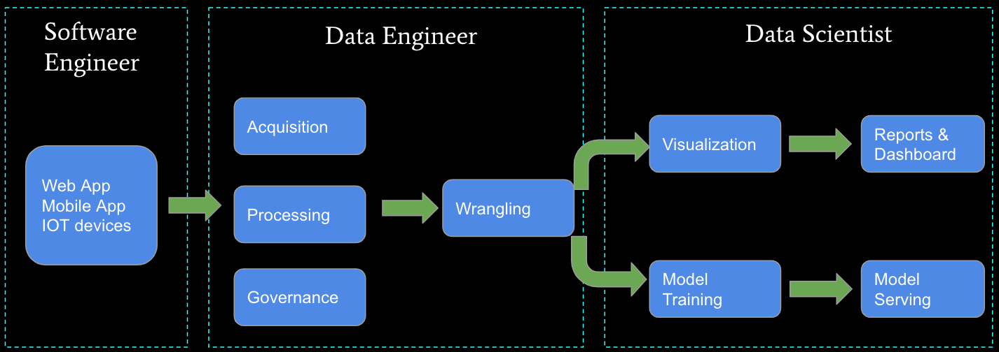
Business Intelligence, Insight, Analysis, … …
The “fun” stuff in data science and AI/ML is the “tip of the iceberg.”
Data engineering is a necessary condition for producing analyzable data. This is often more than 80% of the hard work.
We will do some small data engineering projects in this course.

Slide 9
Common Data Engineering Tasks
Input file formats will be CSV and JSON.
Read and import data into a Jupyter notebook.
Perform “shallow” export of data to MySQL, Neo4j, MongoDB
Perform basic “hygiene” on imported data:
Data types, indexes, keys, … …
Fix data, e.g. split and link, fill in missing values, ignore bad data, … …
… …
Implement and test views to simplify application development and complex queries.

Slide 10
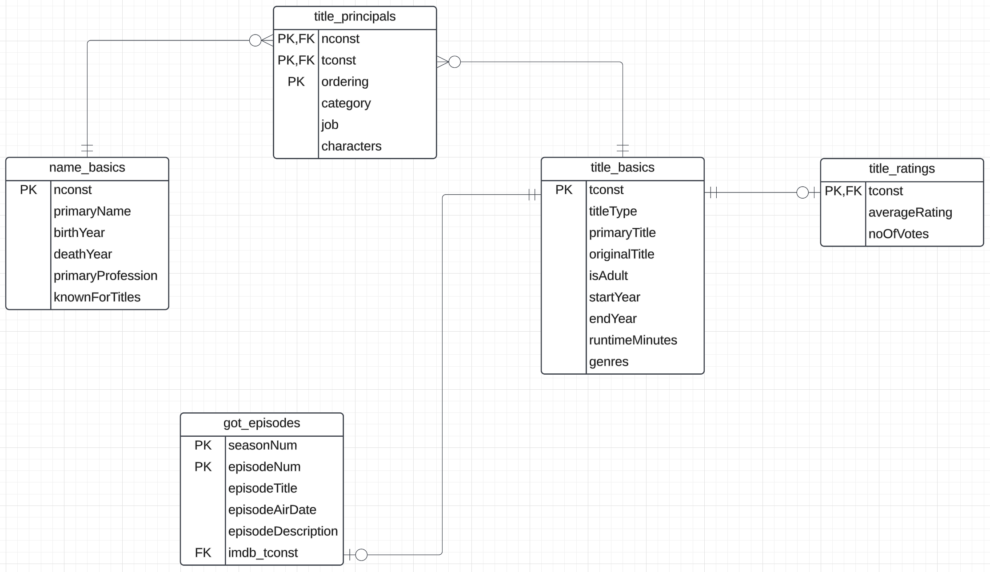
Initial Data – Example
There is a data model implied by the raw input files for IMDB and GoT.
The default types are not good, e.g. TEXT, DOUBLE.
No formal definition of keys, foreign keys, … …
Basic constraints missing.

Slide 11
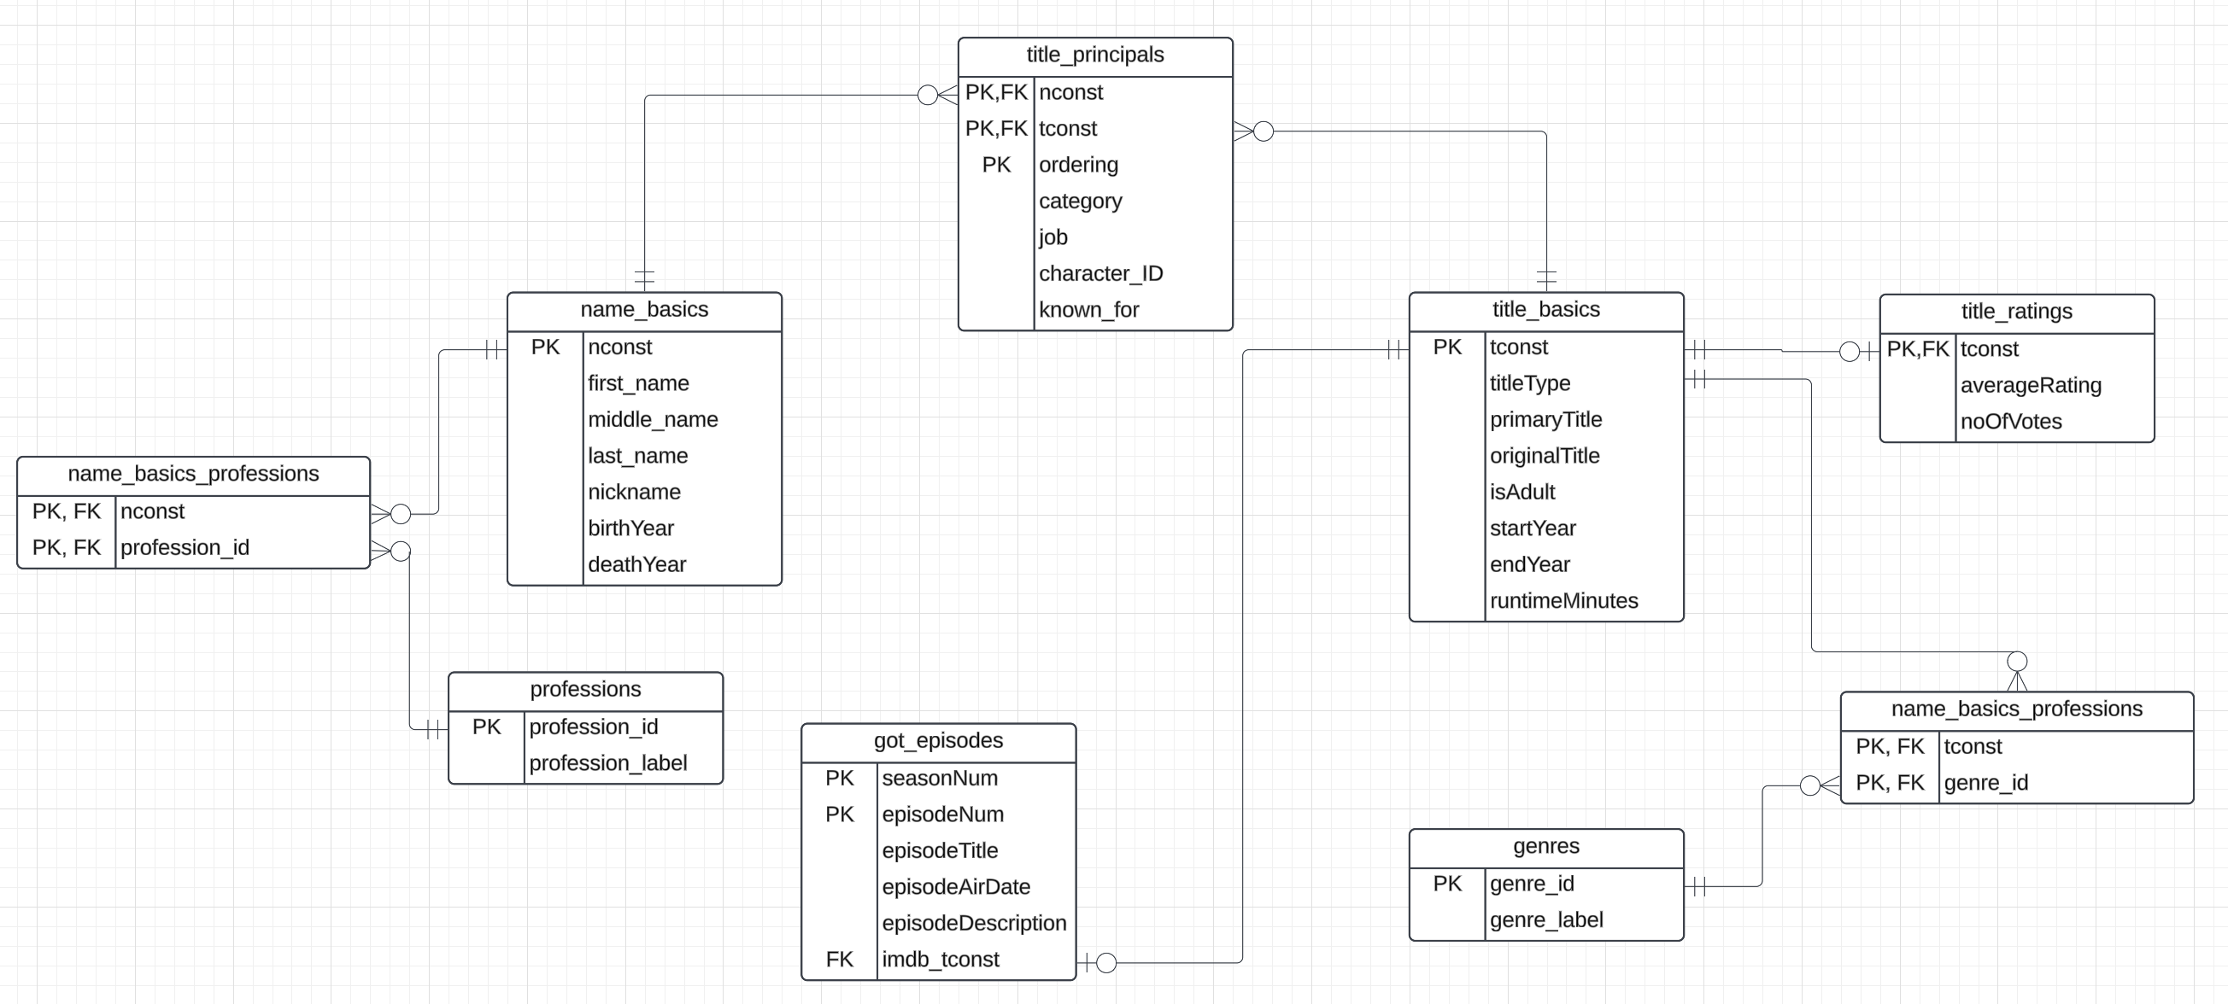
Initial Cleanup – Example

Slide 12
Advanced Data Engineering and Insight
12 | COMS W4111_002_2025_1 – Introduction to Project Template © Donald F. Ferguson, 2025

Slide 13
Advanced Data Engineering and Insight
Data engineering is an extremely complex and challenging topics and environment. There are also complex, powerful specialized tools.
We cannot cover the complexities and tools in sufficient detail in this class.
So, data engineering will be confined to
Complex queries to extract data from Neo4j and MongoDB and load into MySQL.
Defining a data model that better supports complex query.
Transforming the loaded files, MongoDB and Neo4j data into the to be schema using relatively complex SQL
Creating views using complex SQL.

Slide 14
Example
with one as (select, nconst, name_basics.primaryProfession,
substr(name_basics.primaryProfession, 1, locate(',', name_basics.primaryProfession)-1) as p1,
substr(name_basics.primaryProfession, locate(',', name_basics.primaryProfession)+1) as remainder
from name_basics),
two as ( select nconst, one.primaryProfession,
p1, substr(remainder, 1, locate(',', remainder) -1) as p2, substr(remainder, locate(',', remainder)+1) as p3 from one),
three as ( select nconst, primaryProfession,
if(p1='', NULL, p1) as p1, if(p2='', NULL, p2) as p2, if(p3='', NULL, p3) as p3 from two),
four as (select nconst, p1 as profession
from three union select nconst, p2 as profession from three
union select nconst, p3 as profession from three)
select
*
from four;

Slide 15
Full-Stack Web Application
15 | COMS W4111_002_2025_1 – Introduction to Project Template © Donald F. Ferguson, 2025

Slide 16
Introduction and Overview
Full-Stack Web Application
16 | COMS W4111_002_2025_1 – Introduction to Project Template © Donald F. Ferguson, 2025

Slide 17
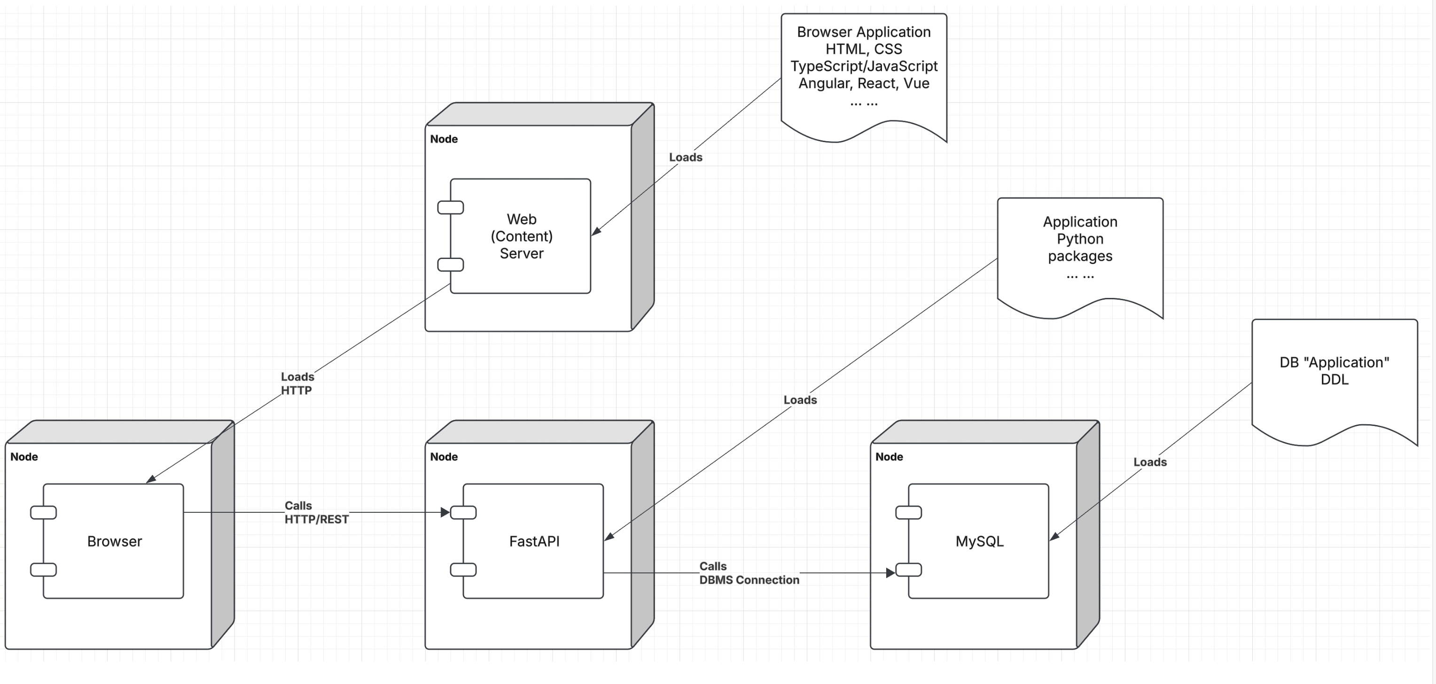
Let’s Look at the Programming Project

Slide 18
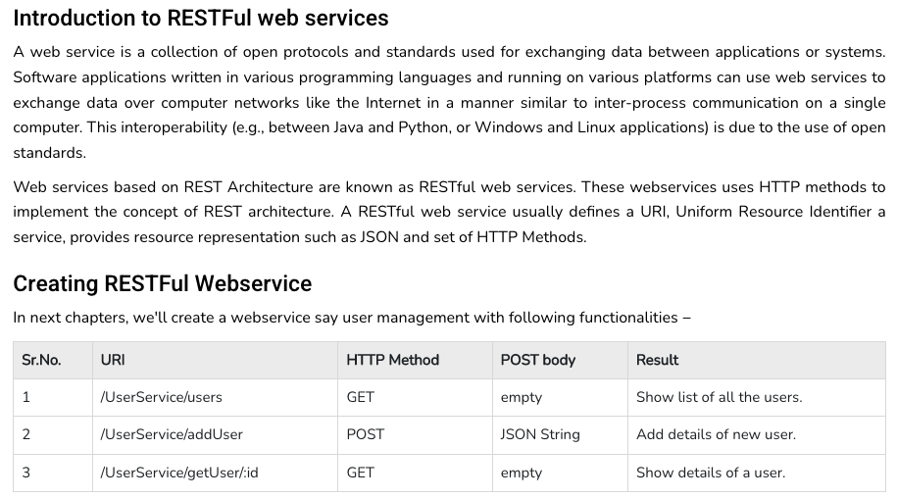
REST (https://www.tutorialspoint.com/restful/restful_introduction.htm)

Slide 19
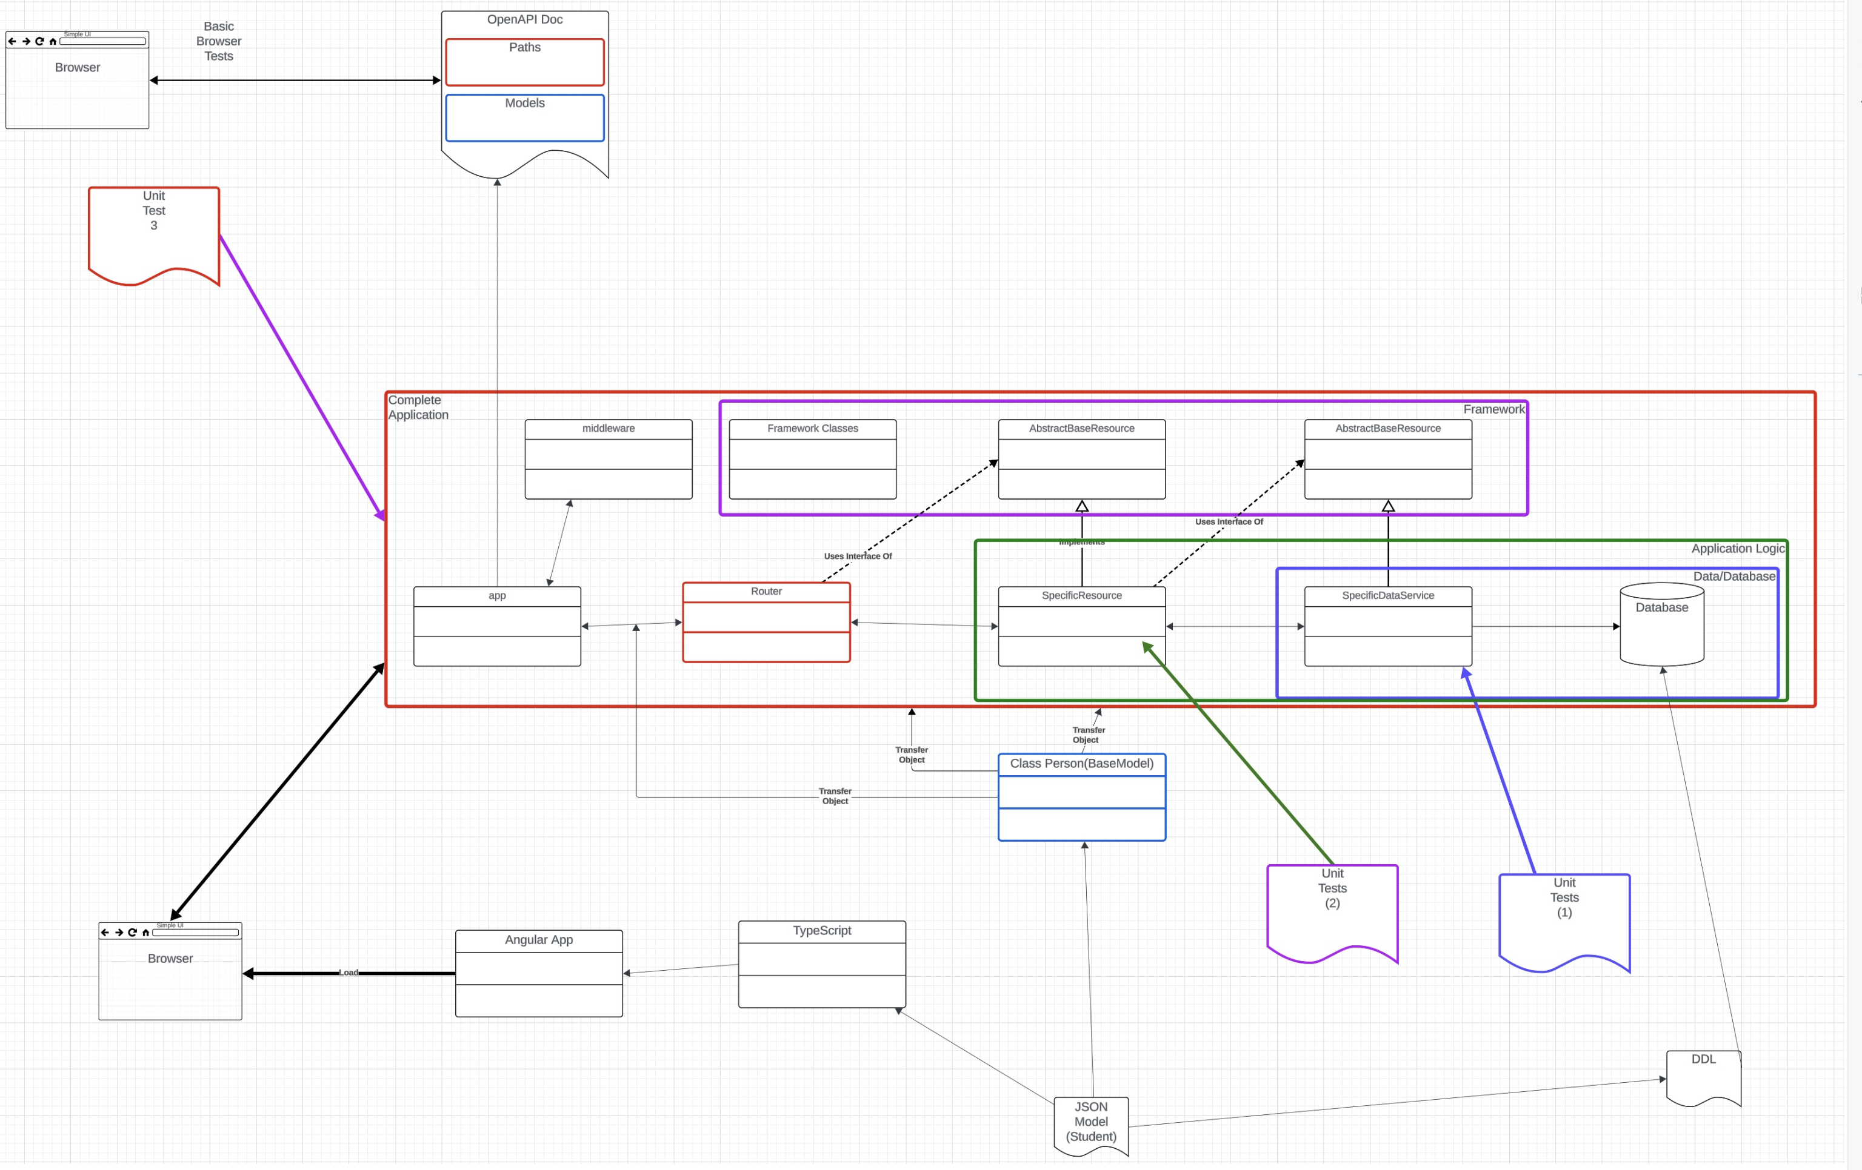
Let’s Look at the Programming Project

Slide 20
Developing a Resource
Full-Stack Web Application
20 | COMS W4111_002_2025_1 – Introduction to Project Template © Donald F. Ferguson, 2025

Slide 21
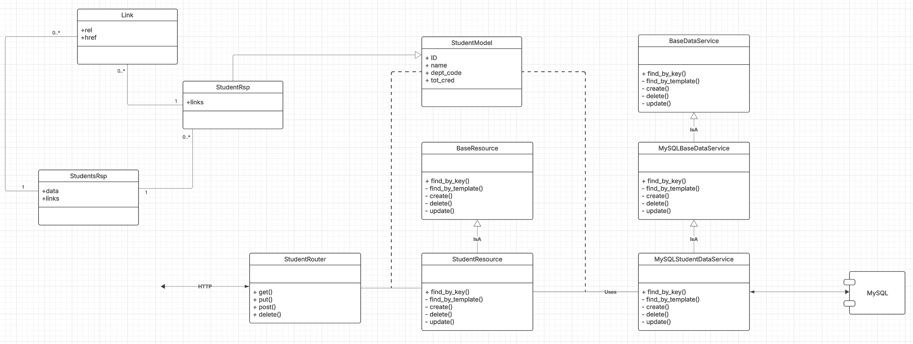
Basic Development Process

Slide 22
Sprint 0
22 | COMS W4111_002_2025_1 – Introduction to Project Template © Donald F. Ferguson, 2025

Slide 23
Sprint 1 – Homework 3B
Very simple
Clone the project.
Install the required packages. (pip and requirements.txt)
Demonstrate that you can execute all of the cells in the Sprint-1 notebook.
Provide a short description or link to the dataset you want to use, or indicate that you plan to use the IMDB, GoT sample data.
You can try to execute interactive_app/application/main.py and go to localhost:8001/docs
You can try to install Angular (https://v17.angular.io/guide/setup-local) and execute interactive_app/web_ui, but we will do another tutorial.

